Slide 1
D-37 Webform
SUBSEQUENT INJURY

Slide 2
D-37 Webform
Objectives
Navigation
Submission
At the completion of this module, training participants will be able to complete submissions for the D-37 webform.
Notes:
TIP: Use this slide as the 2nd slide in each Module deck. If the module is broken down into sub-sections, then use this slide after each Section Divider.

Slide 3
The D-37 Webform
OVERVIEW
The D-37 (subsequent injury) webform allows users to submit initial and supplemental subsequent injury data. Some things to note about the D-37:
It is only available to insurer, TPA, and attorney user types
All initial and supplemental requests must be submitted through the CARDS D-37 webform. WCS will no longer accept paper copies or email submissions, effective June 2, 2025
To initiate the form, the user must link to an existing claim
The D-37 consists of 8 parts, collecting information about the request along with multiple document uploads
Once the request is submitted, the Subsequent Injury Unit will begin reviewing the request to determine the validity of the request and that all criteria has been met pursuant to the Nevada Revised Statutes (NRS) and Nevada Administrative Code (NAC)
The Ticket Number (TK-0000-000) will be linked to the request and can be used for communication with the division if additional documentation or information is requested once the review of the request has begun
Notes:
Note: This is a overview slide that will give you as a trainer the opportunity to give a bit of background information on the purpose of the D-37. Most of the audience should already be familiar with the D-37 but depending on the group, you may want to provide some extra context.

Slide 4
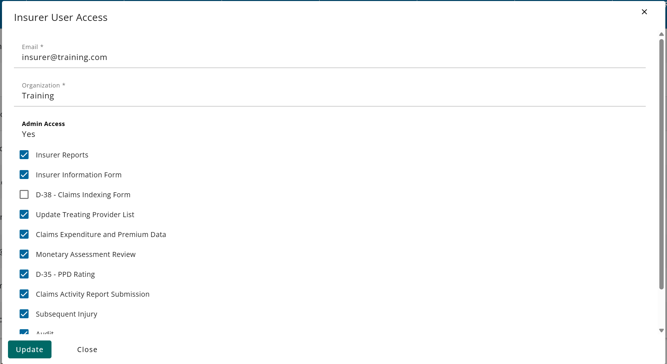
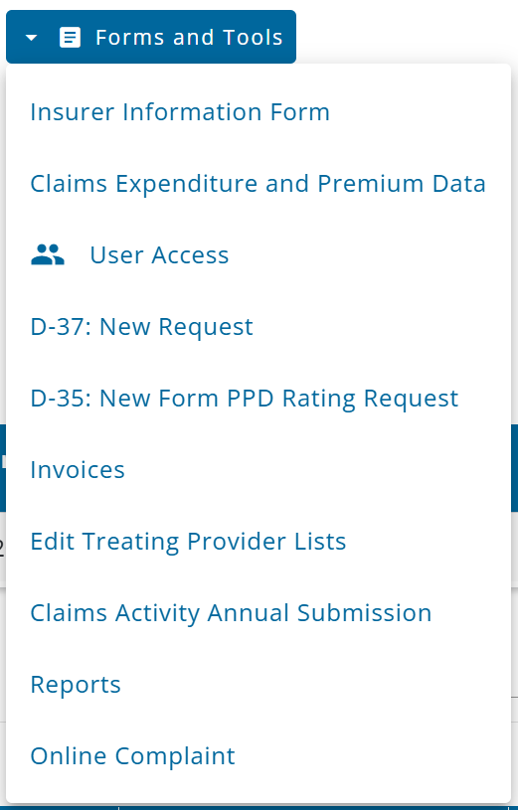
D-37 User Permissions
USER ACCESS TO THE WEBFORM
Permissions for the D-37 webform can only be set by an account administrator. Account admins can set or change permissions for any active user from the User Access Management page, available from the Forms and Tools menu. Please contact your account administrator for access to the Subsequent Injury D-37 webform.
Notes:
Note: Most of the user management access pages are currently not appropriate to show in their entirety as they contain active personal email addresses. Trainers may verbally elaborate on the User Access Management page as well as refer to the CARDS 101 training for additional information.
Insurers and TPAs are required to register for the 101A training, while attorneys should register for the 205 training. If you do not have individual external access to CARDS, please contact your administrator to request access to the Subsequent Injury module. If you are unsure who your administrator is, you may email CARDS@dir.nv.gov to obtain this information.
When contacting us, please specify your name and the purpose of your inquiry, which is to facilitate the submission of D-37 requests.

Slide 5
Navigating to the D-37 Webform
If a user has been granted subsequent injury permissions, they will have multiple ways to access the D-37 webform:
The Forms and Tools menu. You may select D-37: New Request (on the right side of the screen)
The action menu on individual claims in the claim submission table – the Claim must be in the “Accepted” status to initiate the webform from the Claim Submissions table
The user may select the ellipsis menu (three
dots) located on the right side of the screen
and then select on D-37: New Request

Slide 6
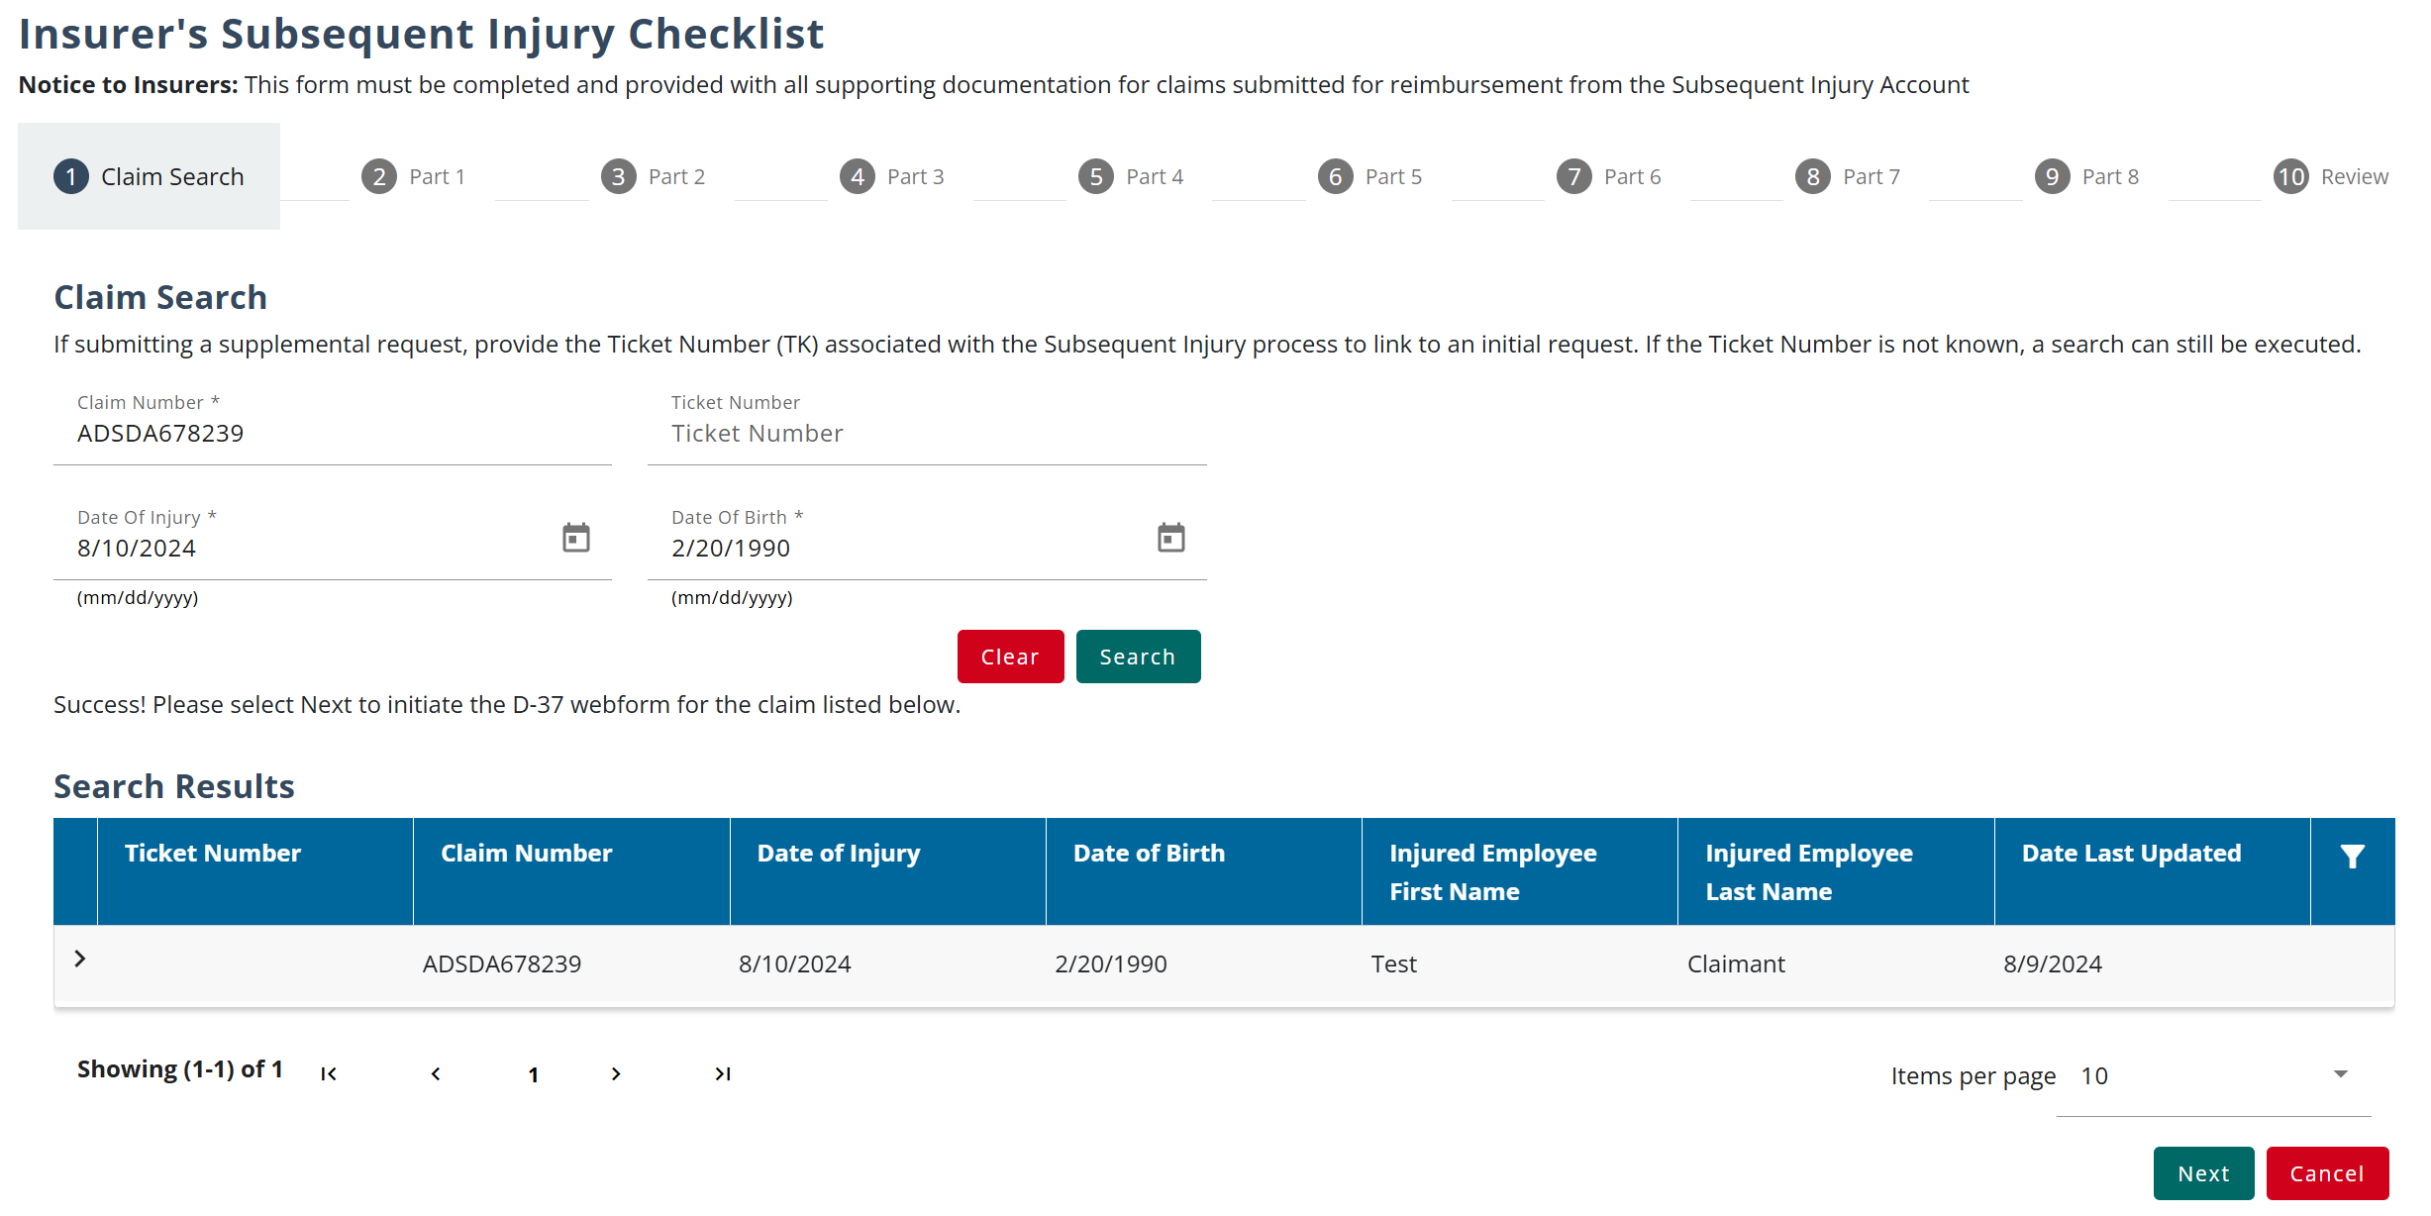
Claim Search on the D-37 Webform
To begin a new D-37 form, you must have a valid claim number along with the date of injury and date of birth. Upon successful search of a claim, the user can continue completing the request.
The user should select the
appropriate claim
corresponding to the
request and then select the
“Next” button

Slide 7
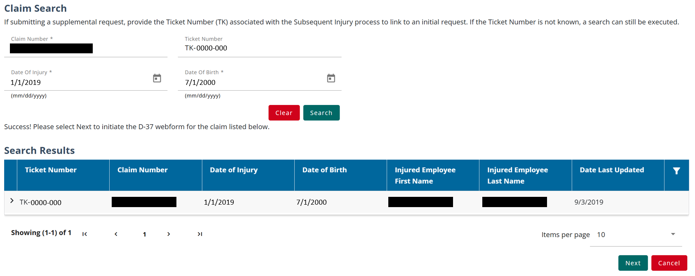
Claim Search on the D-37 Webform
For supplemental requests, if a ticket number was provided for a previous request, the number may also be used as an additional search parameter.

Slide 8
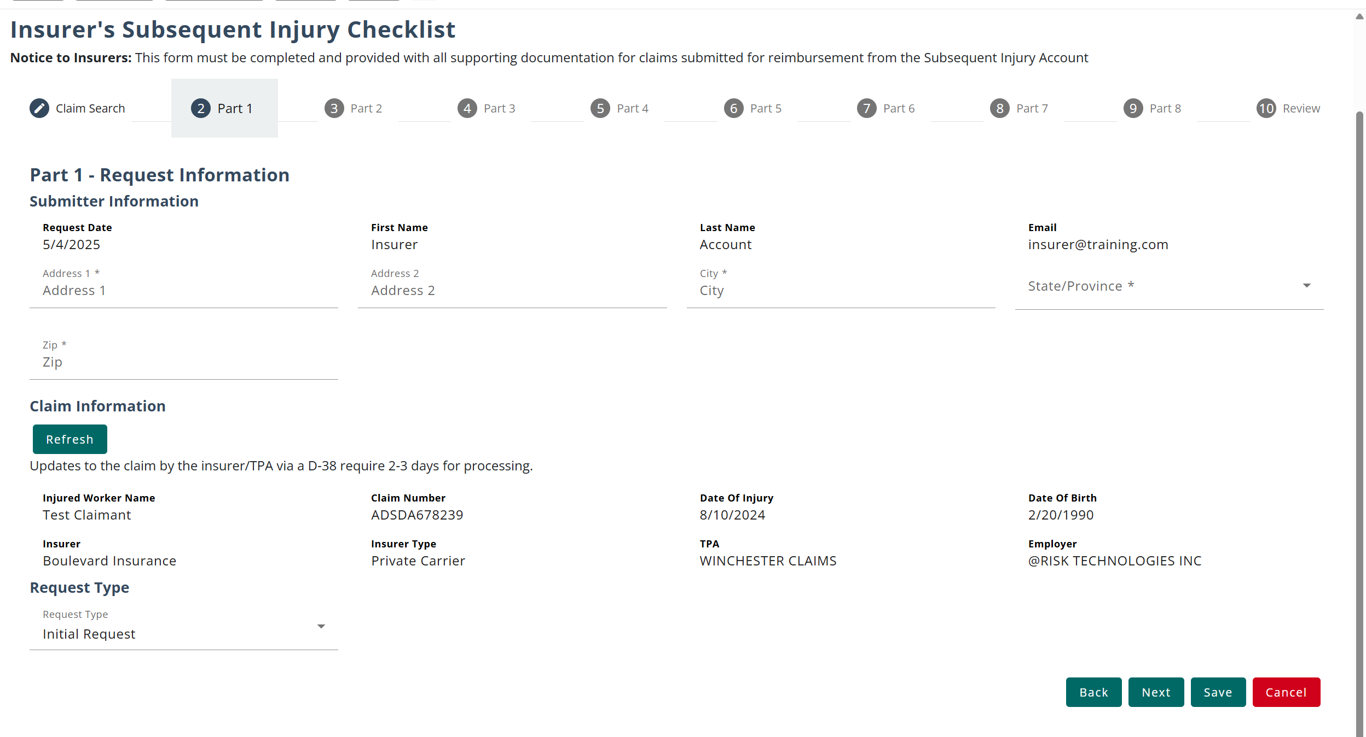
Part 1 of the D-37 Webform
After you select your claim, you may advance to the next page and begin filling out the D-37. Part 1 of the webform collects basic information about the submitter and the user can verify the claim information
Note: Use the save button if you need to fill out the webform over multiple sessions, if you leave the page or press the cancel button your progress will not be saved.
Note: The Request Type will prepopulate, based on whether the Claim is linked to an existing request
Notes:
Note: Incorporate some storytelling with explaining the filling out of the D-37. For example,” The D-37 is a long form and requires a lot of document attachments. So, you might get through a few parts and realize that you need to go ask someone to send you another document you are missing, or that it’s noon and you’re ready for lunch. You can use the save button to keep your progress and access the form again later from the filing history tab.

Slide 9
Part 2 of the D-37 Webform
Before continuing with the request, a Letter of Application must be uploaded, detailing the reason for the Subsequent Injury request. Additional requirements on what to include in the letter can be found on the WCS website**
**Note to WCS – if you wish to add a link to the page where instructions could be found, it would be beneficial to add those to this slide
Notes:
Note: Incorporate some storytelling with explaining the filling out of the D-37. For example,” The D-37 is a long form and requires a lot of document attachments. So, you might get through a few parts and realize that you need to go ask someone to send you another document you are missing, or that it’s noon and you’re ready for lunch. You can use the save button to keep your progress and access the form again later from the filing history tab.

Slide 10
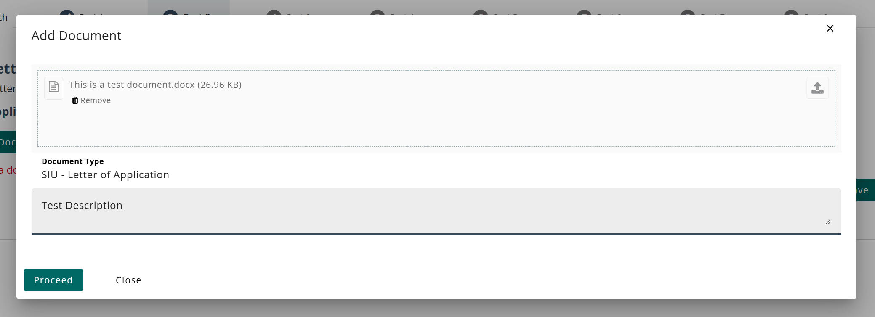
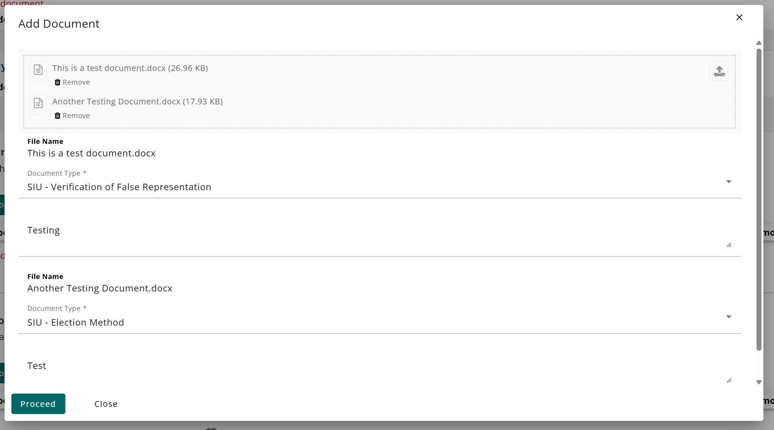
Uploading Documents on the Webform
Documents will be required to be submitted throughout the webform. Some sections only allow a single upload, while others can allow multiple uploads.
Allowed document formats for
upload include MS Word, MS Excel
and PDF.
Notes:
Note: Incorporate some storytelling with explaining the filling out of the D-37. For example,” The D-37 is a long form and requires a lot of document attachments. So, you might get through a few parts and realize that you need to go ask someone to send you another document you are missing, or that it’s noon and you’re ready for lunch. You can use the save button to keep your progress and access the form again later from the filing history tab.

Slide 11
Uploading Documents on the Webform
Once the documents have been added to the form, they will be viewable in the respective section and can be removed if desired.
Notes:
Note: Incorporate some storytelling with explaining the filling out of the D-37. For example,” The D-37 is a long form and requires a lot of document attachments. So, you might get through a few parts and realize that you need to go ask someone to send you another document you are missing, or that it’s noon and you’re ready for lunch. You can use the save button to keep your progress and access the form again later from the filing history tab.

Slide 12
Question: How will D-37 reimbursement requests for Subsequent Injury be submitted?
Knowledge check
By Email
Delivered to Carson City DIR office
Via CARDS D-37 Webform
Delivered to Las Vegas DIR office
To respond, please put your answers in the chat!

Slide 13
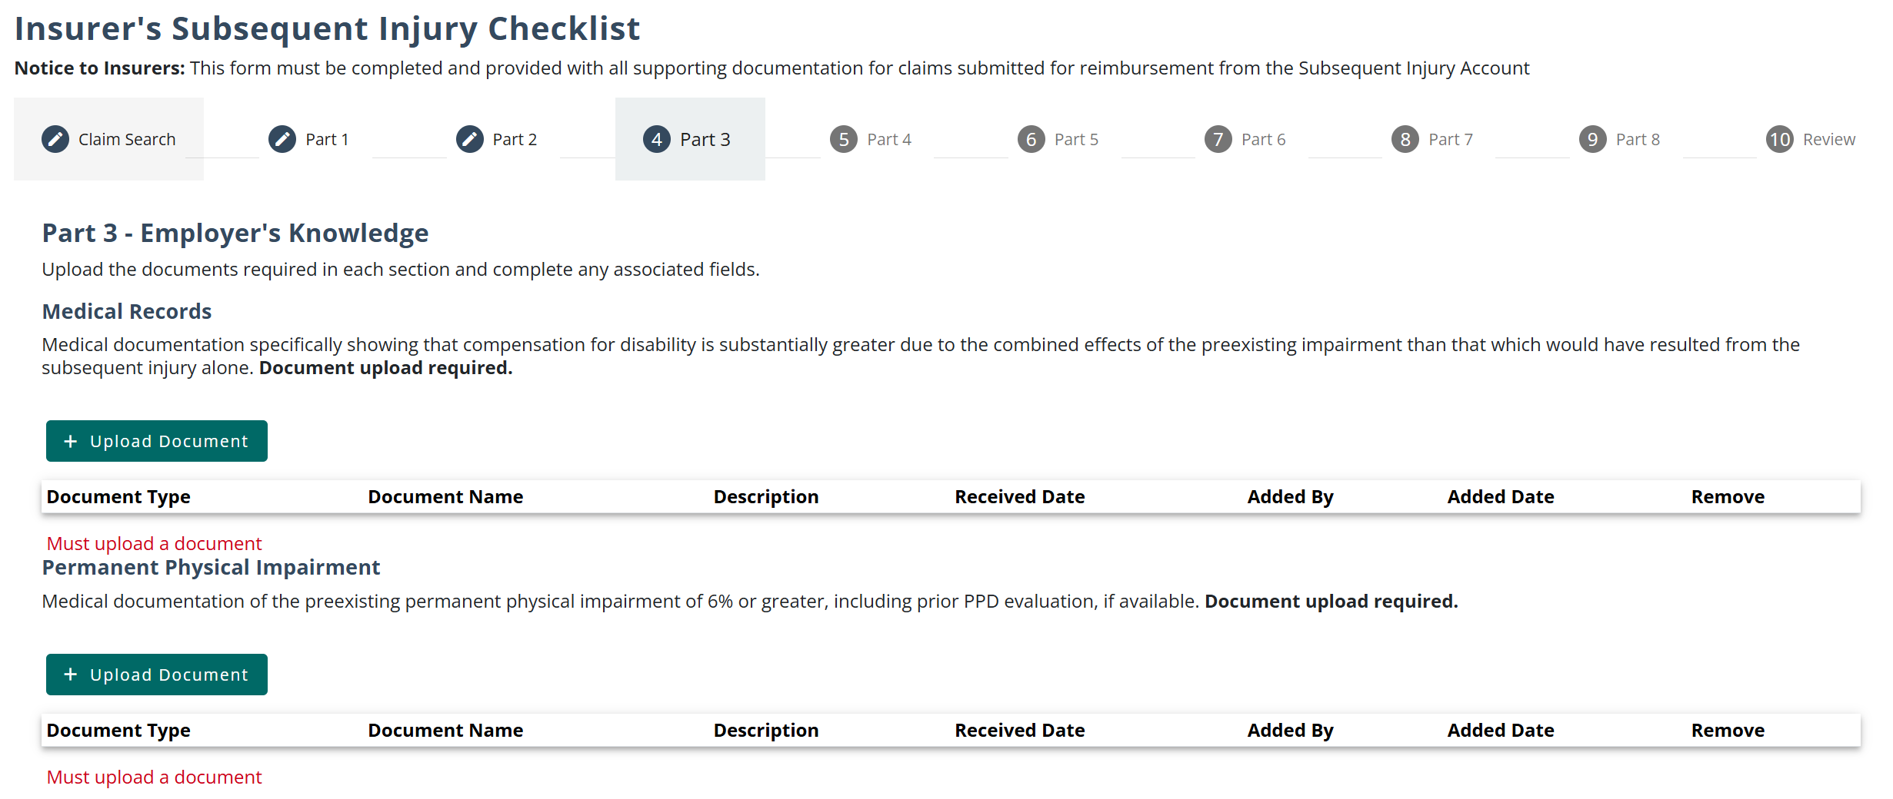
Part 3 of the D-37 Webform
Information about the employer’s knowledge of the injury will be collected on Part 3 of the webform. This section consists of both data fields and document uploads.
Notes:
Note: Incorporate some storytelling with explaining the filling out of the D-37. For example,” The D-37 is a long form and requires a lot of document attachments. So, you might get through a few parts and realize that you need to go ask someone to send you another document you are missing, or that it’s noon and you’re ready for lunch. You can use the save button to keep your progress and access the form again later from the filing history tab.

Slide 14
Part 3 of the D-37 Webform
The employer’s knowledge section requires a body part percentage to be added to the request. The body parts that will be available on the form are body parts that have been accepted on the approved claim that was linked to the request. If there is a body part not displayed on the form that should be included with the request, the claim must first be updated, using the D-38 webform.
Notes:
Note: Incorporate some storytelling with explaining the filling out of the D-37. For example,” The D-37 is a long form and requires a lot of document attachments. So, you might get through a few parts and realize that you need to go ask someone to send you another document you are missing, or that it’s noon and you’re ready for lunch. You can use the save button to keep your progress and access the form again later from the filing history tab.

Slide 15
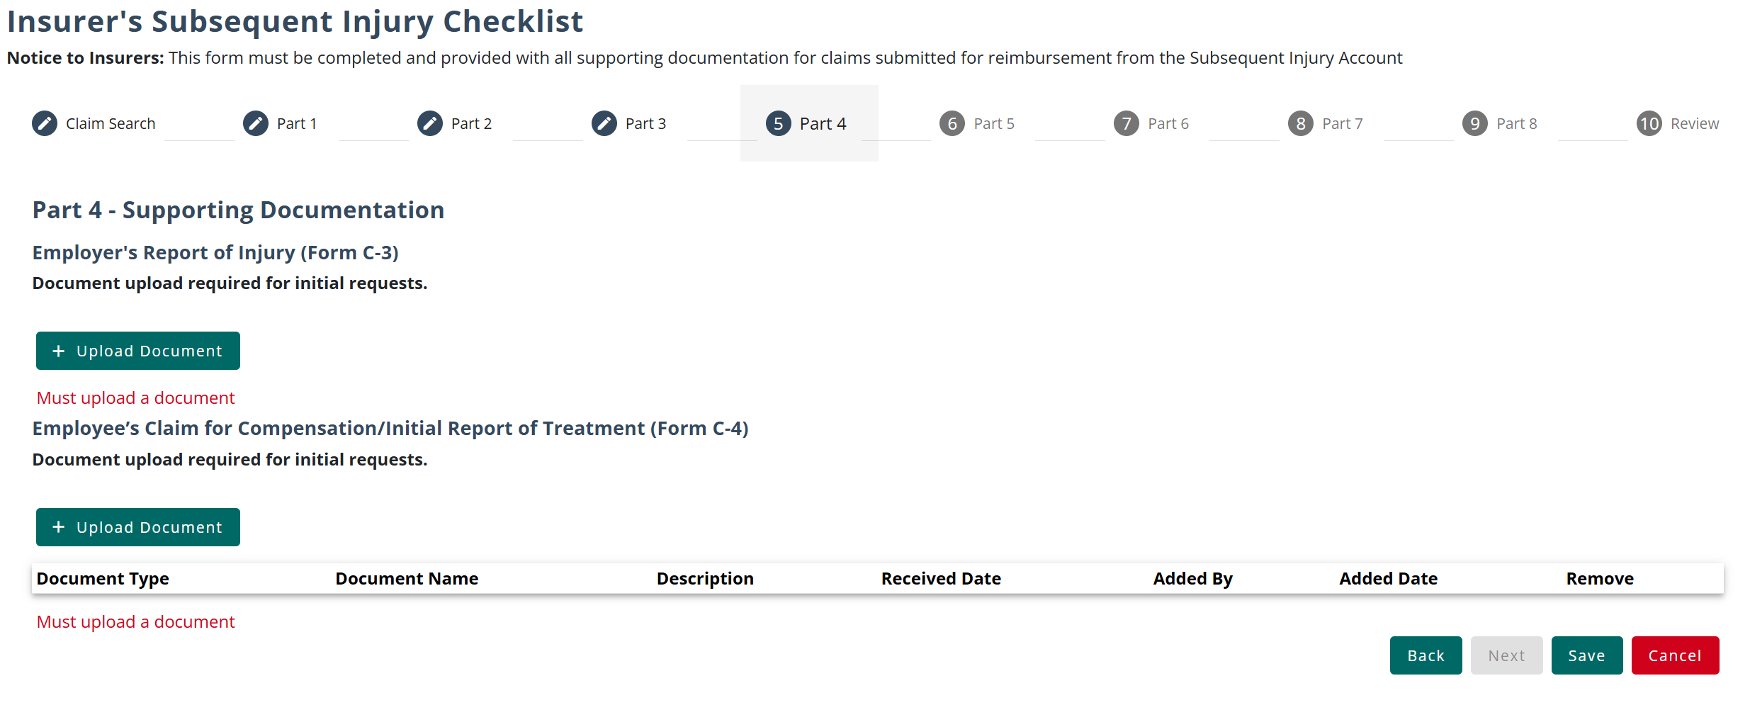
Part 4 of the D-37 Webform
For initial requests, the webform will require an upload of the C-3 Form and C-4 Forms. These documents may also be uploaded for supplemental requests.
Notes:
Note: Incorporate some storytelling with explaining the filling out of the D-37. For example,” The D-37 is a long form and requires a lot of document attachments. So, you might get through a few parts and realize that you need to go ask someone to send you another document you are missing, or that it’s noon and you’re ready for lunch. You can use the save button to keep your progress and access the form again later from the filing history tab.

Slide 16
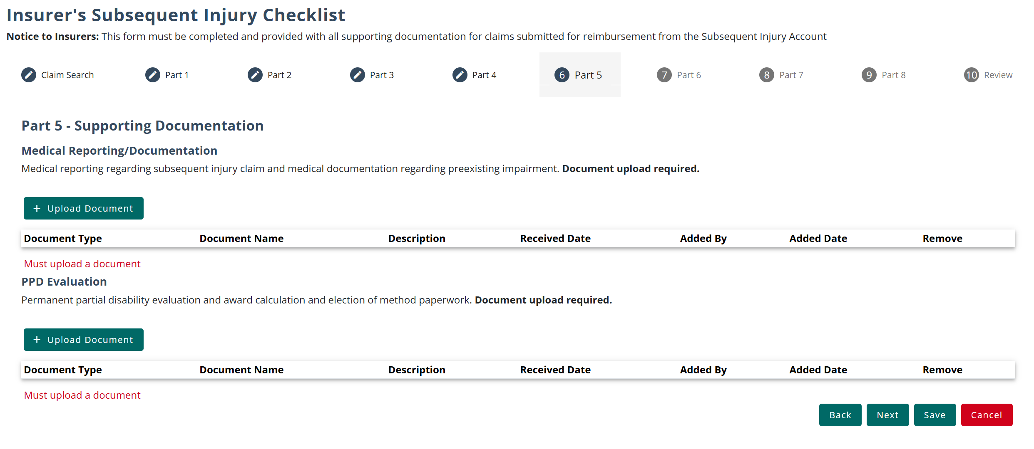
Parts 5 through 7 of the D-37 Webform
Parts 5 through 7 of the webform have additional sections for supporting documentation that may be uploaded along with the request. Some sections will be required uploads, while others may be optional.
Notes:
Note: Incorporate some storytelling with explaining the filling out of the D-37. For example,” The D-37 is a long form and requires a lot of document attachments. So, you might get through a few parts and realize that you need to go ask someone to send you another document you are missing, or that it’s noon and you’re ready for lunch. You can use the save button to keep your progress and access the form again later from the filing history tab.

Slide 17
Part 8 of the D-37 Webform
The last part of the webform will collect Expenditure Information related to the request. This will be used to determine the total amount requested. The amounts collected will include medical, compensation, and vocational rehabilitation expenditures.
Any expense marked with an asterisk (*) must be filled in with an
amount or zero; otherwise, you will not be able to continue.
Notes:
Note: Incorporate some storytelling with explaining the filling out of the D-37. For example,” The D-37 is a long form and requires a lot of document attachments. So, you might get through a few parts and realize that you need to go ask someone to send you another document you are missing, or that it’s noon and you’re ready for lunch. You can use the save button to keep your progress and access the form again later from the filing history tab.

Slide 18
Part 8 of the D-37 Webform
The Expenditures Section also allows the user to include miscellaneous costs, that require a description to be included. All the total expenditure amounts (medical, compensation, vocational rehabilitation, and miscellaneous) will be totaled, and then subtracting the Subrogation amount, will populate the Grand Total Expenditures amount.
The subrogation amount will
always be a negative value.
Notes:
Note: Incorporate some storytelling with explaining the filling out of the D-37. For example,” The D-37 is a long form and requires a lot of document attachments. So, you might get through a few parts and realize that you need to go ask someone to send you another document you are missing, or that it’s noon and you’re ready for lunch. You can use the save button to keep your progress and access the form again later from the filing history tab.

Slide 19
D-37 Webform Confirmation
The last page of the webform will request confirmation of the request, and upon submission, a confirmation message will populate on the homepage notifying the submitter that the request has been successfully submitted.
Notes:
Note: Incorporate some storytelling with explaining the filling out of the D-37. For example,” The D-37 is a long form and requires a lot of document attachments. So, you might get through a few parts and realize that you need to go ask someone to send you another document you are missing, or that it’s noon and you’re ready for lunch. You can use the save button to keep your progress and access the form again later from the filing history tab.

Slide 20
D-37 (Subsequent Injury) Webform Submissions
After saving a draft, you can access the D-37 webform from the Filing History tab on your homepage to continue your submission. When the webform is submitted, it will be in the Pending status while the internal staff is completing their review of the request.

Slide 21
D-37 (Subsequent Injury) Webform
After submitting the webform, the request may be sent back to the user if corrections are needed on the form. The status of the request will be displayed in the Filing History table. When the request is in this status, the form may be reopened to update any fields that need correction.
If no corrections are required on the form, the internal WCS staff will begin their review of the submitted documentation to process the request and determine the amount allowed versus disallowed.

Slide 22
Question: Who should be contacted regarding user permissions?
Knowledge check
DIR Subsequent Injury Coordinator
Insurer/TPA Administrator
DIR email: CARDS@dir.nv.gov
Both B and C
To respond, please put your answers in the chat!

Slide 23
Questions?
CARDS 203: D-37 subsequent injury webform
For any questions after this presentation, reach out to wcshelp@dir.nv.gov
You may contact:
Blanca Villarreal-Rodriguez, SI Coordinator - Compliance/Audit Investigator III at brodriguez@dir.nv.gov
Jolene Pirnie, Insurer Compliance Unit Chief Compliance/Audit Investigator at jpirnie@dir.nv.gov
Alisa Reed, Compliance/Audit Investigator III at areed@dir.nv.gov
Cristina Grimm, Administrative Assistant II at c.grimm@dir.nv.gov
Notes:
Note: Replace the date placeholder with the date of the presentation to stakeholders and update contact information as necessary

